Slide 1
Grade 8 to 9 COURSE SELECTION
Making Good Choices
Notes:
Welcome- course selection
We will work through course selections, changes to grade 9 curriculum and pathway planning

Slide 2
The Grade 9 Program
6 Compulsory and 2 Elective Courses
English
Science
Geography
French
Math
Religion
2 Elective courses
De-streamed* ENL1W OR Locally
Developed level ENG1L
De-streamed* SNC1W OR Locally
Developed level SNC1L
ACADEMIC level offered
De-streamed* MTH1W OR Locally
Developed level MAT1L
OPEN LEVEL
Notes:
There have been many changes to the grade 9 program in recent years and more will be coming. In order to prepare for these changes, we have made some alterations to what is offered in grade 9
Explain how this will work

Slide 3
Levels of Study in High School
Workplace Level Grade 11 & 12
PATHWAY
Workforce, Military, Apprenticeship
Applied Level Grade
10
College Level Grade 11 & 12
PATHWAY
College, Military, Apprenticeship, Workforce
Locally Developed Level Grade
9 & 10
University Level Grade 11 & 12
PATHWAY
University, College, Apprenticeship, Workforce, Military
Academic
Level Grade 10
Academic/
De-Streamed Grade 9
Academic/
De-Streamed Grade 9

Slide 4
De-Streamed Courses
Grade 9 is, now, a lot like grade 8
Students at all levels of achievement will be in the same class
This gives you one more year of opportunity for academic growth and to develop your Learning Skills
After grade 9 you and your parent/guardian will decide which level of study to take in grade 10 - based on: pathway plan, achievement and Learning Skills

Slide 5
DESTREAMED ~MATH, SCIENCE & ENGLISH~
Students will be “de-streamed” into a Math, Science & English course designed for most grade 9 students
Students who opt for Locally Developed Math/Science/English will continue to study at this level*
The new course code is MTH1W1 and SNC1W1
After a year of “de-streamed” grade 9 Math/Science students will choose grade 10 Applied OR Grade 10 Academic Math/Science depending on:
1) Level of Achievement and,
2) Pathway plan
* If you start with L level but want to change, your Guidance Counsellor can help you plan for this

Slide 6
Another level of study…
Do you really struggle with a subject(s)? (grades in the 50’s) OR
Is your grade 8 program MODIFIED?
Do you struggle to complete tasks without a lot of assistance?
If you said “yes” to these questions- you might be a good candidate for Locally Developed Level Courses

Slide 7
Parent/Guardian & Teacher Conversations…
Your teacher is available to discuss the options with your parent/guardian
Your teacher knows you, cares about you and wants you to have the best success in grade 9
PLEASE also encourage your parent/ guardian to contact a Guidance Counsellor to discuss pathway planning
(Mr. Devenish or Mrs. Harrison)

Slide 8
PATHWAY OPTIONS
WORKPLACE (military, work, etc.)
APPRENTICESHIP (Skilled Trades)
COLLEGE
UNIVERSITY
ALL of these require your OSSD (Ontario Secondary School Diploma-30 credits) but you can study at different levels which lead you to different pathways.

Slide 9
Earning Your Diploma
Requirement 1
Requirement 2
Requirement 3
30 Credits
18 compulsory credits
12 elective credits
Community Involvement 40 hours—Don’t forget about the First 40 Party!
Literacy Requirement
Test written in Grade 10

Slide 10
Students entering high school in 2021-22+ are required to take a minimum of 2 eLearning courses to fulfill OSSD requirements
There is an “Opt-Out” option for parents/guardians to request their child be exempt from this requirement
They have up to your grade 12 year to “opt out” of this requirement
*More information will be sent home regarding this process

Slide 11
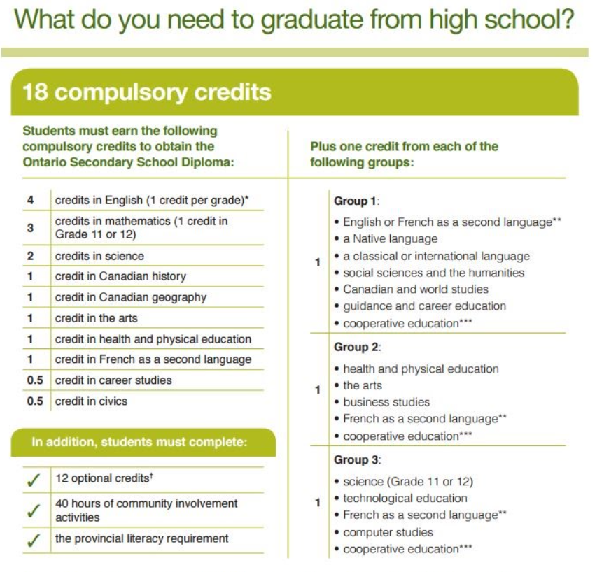

Slide 12
What courses will I take in grade 9?
English (ENL1W or ENG1L)
Math (MTH1W or MAT1L)
Science (SNC1W or SNC1L)
Religion (HRE10)
Geography (CGC1D) OR (CHC2DE*)
French (FSF1D) OR (FEF1D*)
*For Extended French for students coming from French Immersion
+ 2 electives (your choice)

Slide 13
Which electives should I choose?
Choose subjects you enjoy
All Arts courses (Drama, Art & Music have pre-requisites → you need grade 9 or 10 course to be able to take a grade 11 option)
Keep in mind that by the time you graduate you will need:
1 Phys. Ed credit
1 Arts credit (art, drama or music)
1 Tech/Business credit

Slide 14
Gr 9 Elective Course Codes
NAC 10 Fine Art
ADA 10 Drama
AMU 10 Music
AMG 20* Guitar Music
(*open to grade 9 & 10 students)
PPL 10 Gym
HFN 10* Food & Nutrition
(*open to grade 9 & 10 students)
BBI 20* Business
(*open to grade 9 & 10 students)
TGJ 20* Computer Technology
(*open to grade 9 & 10 students)
All at the
Open
level

Slide 15
LOOKING AHEAD→ GRADE 10/11/12 OPTIONS: ALCDSB “TECH” PROGRAMS
These are 2 credits (all morning or all afternoon) & Spaces are limited!
Exploring Technologies & Careers/Civics
Hairstyling and Aesthetics
Construction Technology
Automotive Technology
Hospitality and Foods
Manufacturing Technology

Slide 16
Let’s get started!
Your parent/guardian will approve your course selections through myBlueprint
Update your MyBlueprint selections to reflect what your parent/guardian and teacher recommend based on: your pathway plan, strengths/needs and learning skills
REVIEW your choices
SUBMIT your selections to your parent for final approval on MyBlueprint

Slide 17
FINDING MyBlueprint
HERE

Slide 18
Getting Started…
Choose: HIGH SCHOOL (backpack)

Slide 19
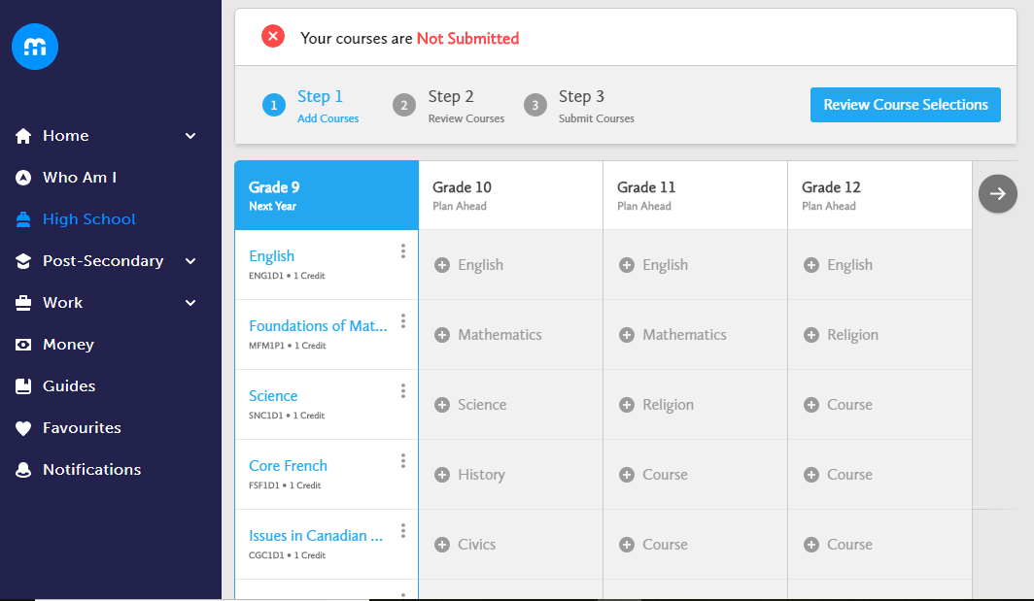
Click on the box and select your course
You can:
Read the course description
See pre-requisites
Change or delete your choice

Slide 20
REVIEW Your Course Selection
SELECT REVIEW

Slide 21
Have a good plan before you “submit”
Use the recommendations your teachers made to make your level choices
Once you “submit” you CANNOT change your choices~ you will have to make an appointment with Mrs. Harrison or Mr. Devenish
You must return your Course Selection form by FRI. MARCH 10, 2023–those who do not, risk not getting their first choice electives

Slide 22
SUBMITTING Course Selections
Submit your course selection

Slide 23
SUBMITTING Course Selections
You will be asked for your parent/guardian’s EMAIL ADDRESS
This will EMAIL your course selection to your parent/guardian where, with the click of a button, they can APPROVE your course selection!
This is then submitted to the Guidance Dept.

Slide 24
Getting Started--Video Tutorial
WATCH this video demonstration on how to choose and SUBMIT student course choices AND how to get your PARENT/GUARDIAN APPROVAL virtually
in myBlueprint!
Course Selection/Submission Video

Slide 25
Fri. March 10, 2023
DUE DATE
Students who submit late forms may not receive the courses of their choice

